Slide 1
网站修订
2019 1106 Confirmation Signature:

Slide 2
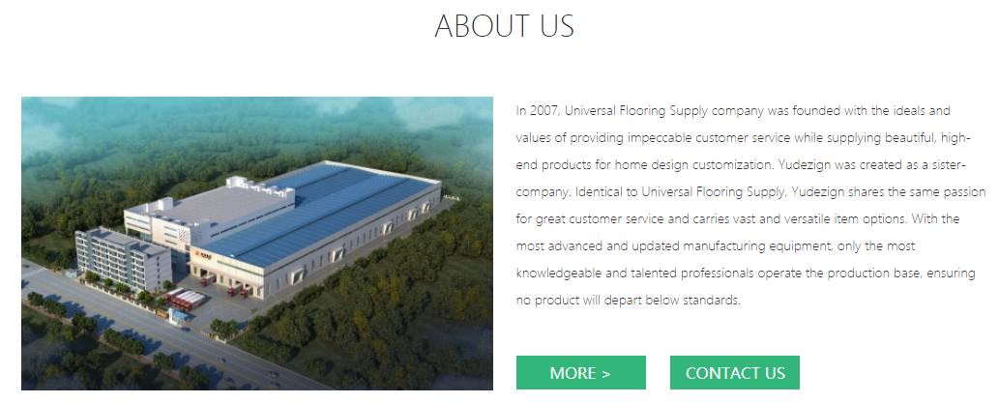
Website address to the below information shown
http://www.yudezign.com/home
In 2007, Yukon Group was founded with the ideals and values of providing impeccable customer service while supplying beautiful, high-end products for residential as well as commercial projects. We are proud to announce the establishment of a sister-company: Yudezign. Identical to Yukon regarding vision and values, Yudezign additionally offers vast and versatile custom cabinetry design options. Our US-based manufacturing site is equipped with the most advanced manufacturing equipment and talented professionals utilizing integrated design-to-completion software, ensuring delivery of consistently high quality products.

Slide 3
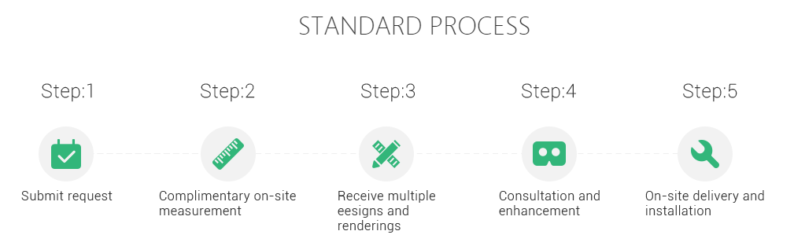
Website address to the below information shown
http://www.yudezign.com/home
这里的内容在此 http://www.yudezign.com/home 网页删除，但是在 http://www.yudezign.com/join 网页中增加，详情请见PPT19

Slide 4
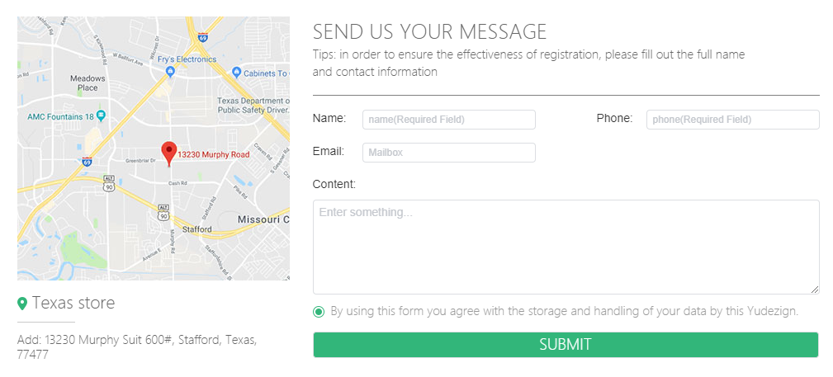
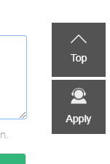
Website address to the below information shown
http://www.yudezign.com/home
INTERESTED? CONTACT US
1. Tips 更改为 Tip
2. registration 更改为 communication
3. 删除“by using this form you agree....Yudezign.”
Yudezign Headquarters
Address: 13246 Murphy Road, Suite 400
Stafford, TX 77477
这里插入的图片换为下列图片
CONTACT US
Notes:
截图

Slide 5
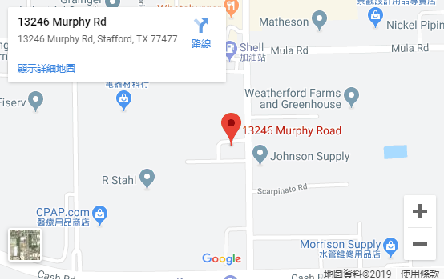

Slide 6
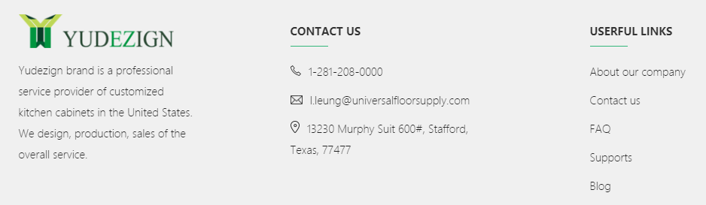
Website address to the below information shown
http://www.yudezign.com/home
USEFUL LINKS
Support
Yudezign is a professional service provider of customized kitchen cabinets in the United States. We provide dealer support from design consultation, production to installation instructions
orders@yudezign.com
13246 Murphy Road, Suite 400
Stafford, TX 77477

Slide 7
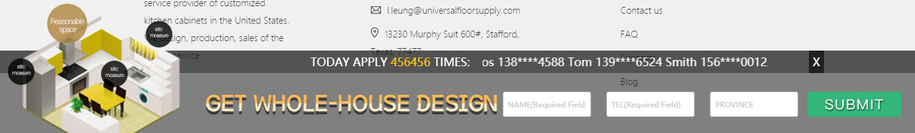
Website address to the below information shown
http://www.yudezign.com/home
删除如上功能
Notes:
???

Slide 8
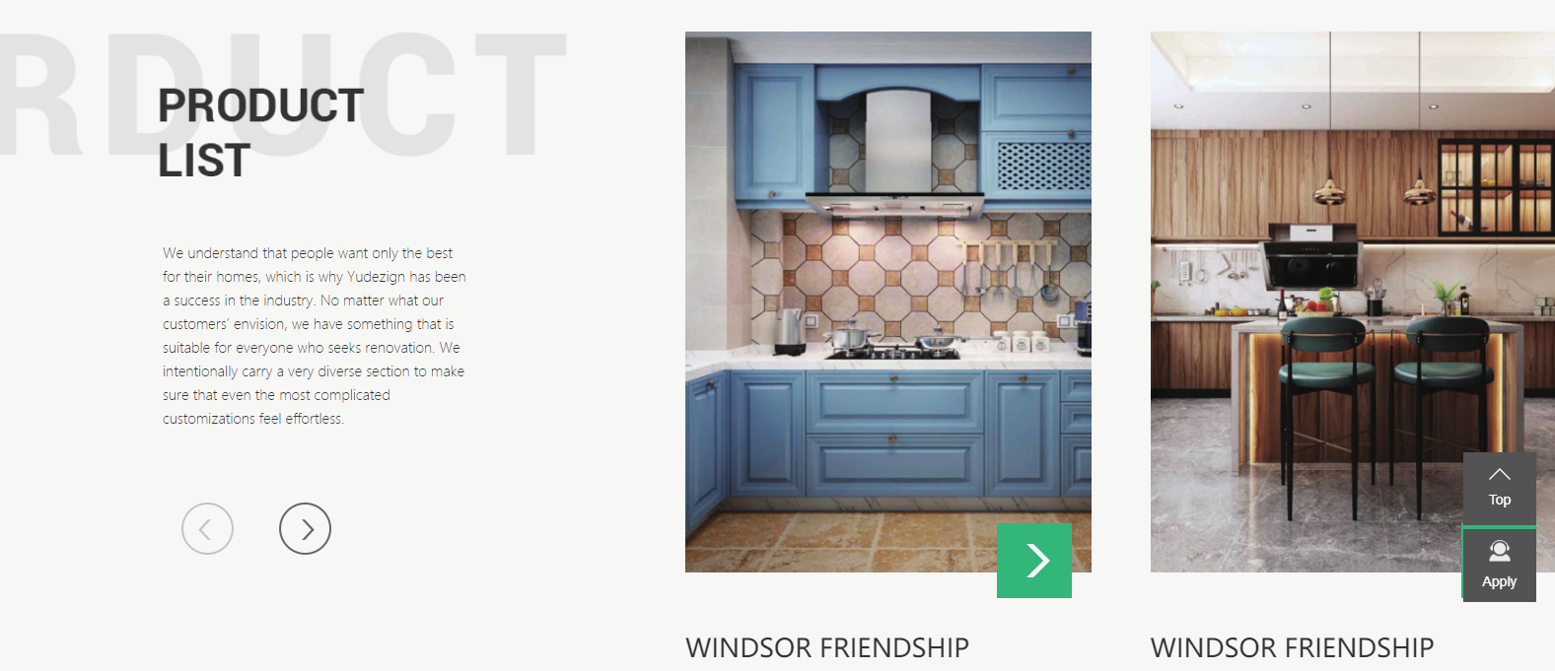
Website address to the below information shown
http://www.yudezign.com/product
后面阴影部分Product的拼写，及前面PRODUCT LIST 全部更改为 COLLECTIONS
COLLECTIONS
We understand that people want unique decor for their homes and the best quality at affordable prices. No matter what our customers envision, we have a solution for every renovation project. We intentionally carry a very diverse selection to make sure that even the most complicated customizations feel effortless.
Notes:
???

Slide 9
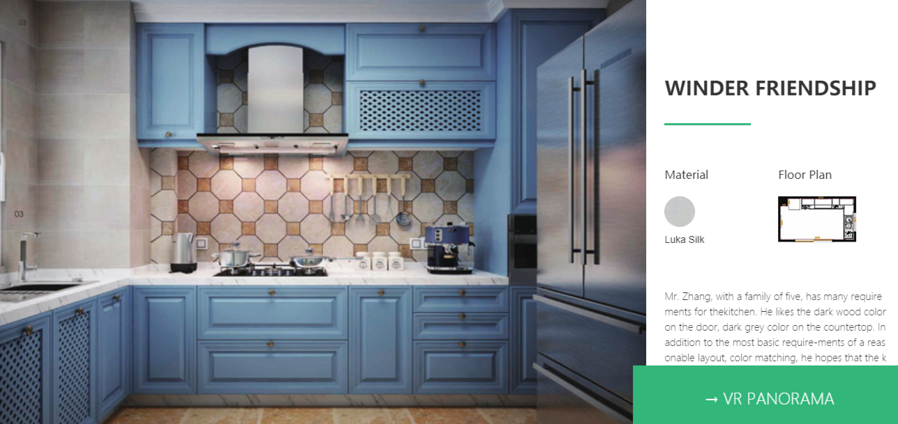
Website address to the below information shown
http://www.yudezign.com/product
暂时不改待图片
这里文字性的结构同 Catalog 一致
Winder Friendship 改成为对应的 Collection Name
Material 更改为 Door Finish，下方的名称更改为对应Finish的名字
Floor Plan 部分全部剔除
最下方英文文字性描述同每个 Collection 的描述一致

Slide 10
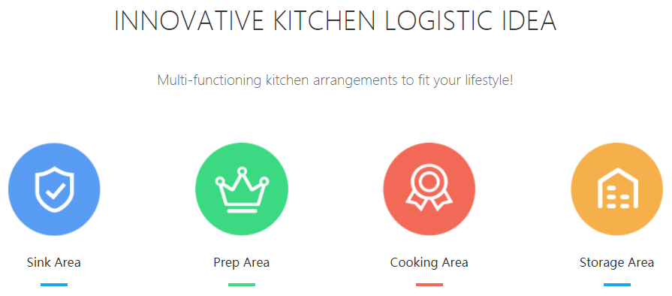
Website address to the below information shown
http://www.yudezign.com/product
删除如上

Slide 11
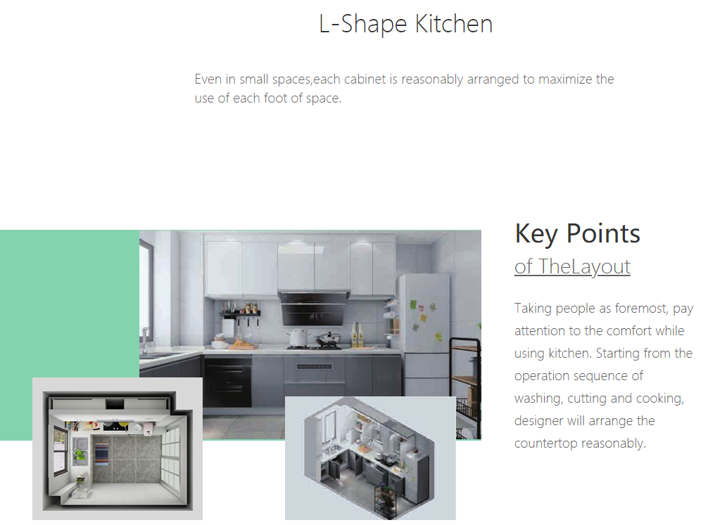
Website address to the below information shown
http://www.yudezign.com/product
暂时不改待图片
题目为 Collection 的名称
下面的描述内容为对应的每一个 Collection 的描述
Key Points 更改为 Door Finish
of TheLayout 更改为 对应的门板色的名称
下面的描述内容为对应此门板色的描述

Slide 12
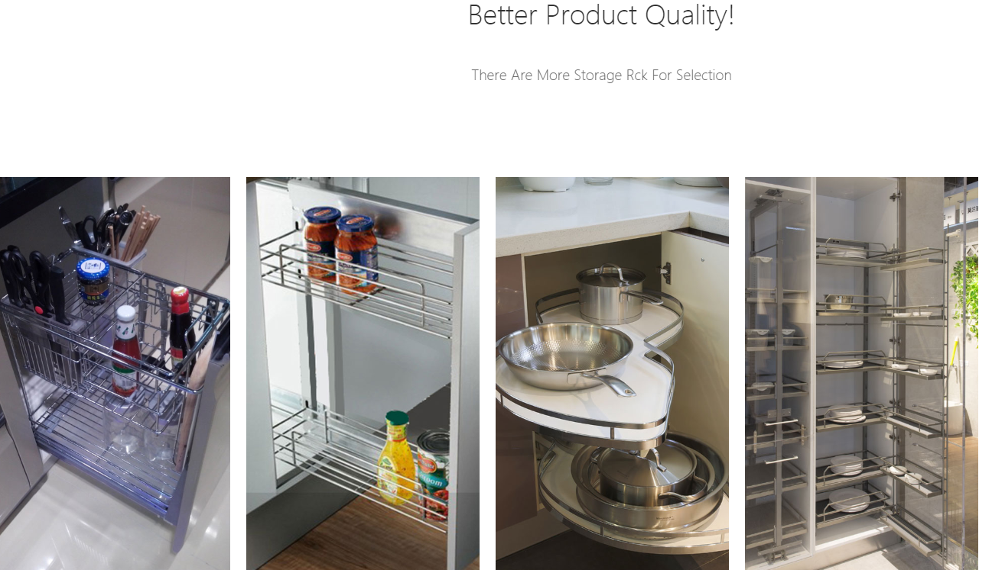
Website address to the below information shown
http://www.yudezign.com/product
Products INSIDE that make your life easier!
Racks for Selection
从左至右（注意此处图片为滚动式图片，要一一对应哈）
Stainless Steel Spice Rack: This conveniently stores condiments and spices as well as frequently used kitchen tools. Perfect for a food preparation area.
Narrow Storage: Maximize your storage; use every inch.
Corner Flying Saucer: Efficient use of corner space for storing pots and pans or pantry items.
Stainless Steel Full Height Pull Out: Organize like a professional

Slide 13
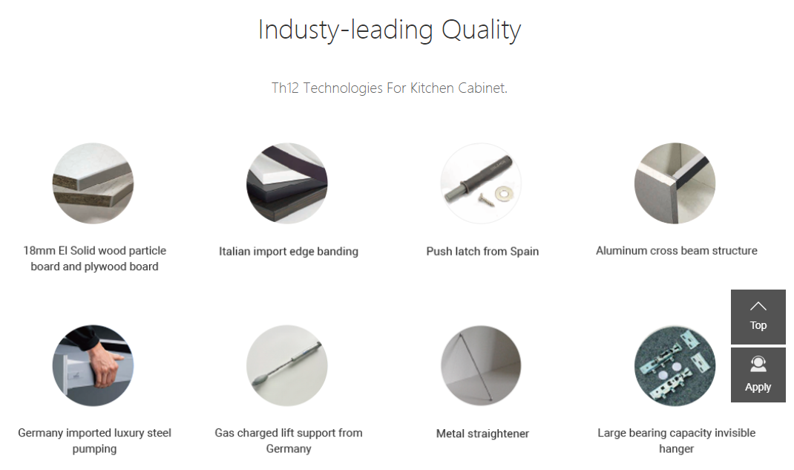
Website address to the below information shown
http://www.yudezign.com/product
Industry
The 12 Technologies For Cabinets
3/4 inch Plywood Carcass Material;
Italian Imported Edge Banding
Imported Push Opening System
Metal Straightener
German Imported Luxury Steel Metalbox
German Imported Liftline Gas Spring
Notes:
Chris: 713 855 7766

Slide 14
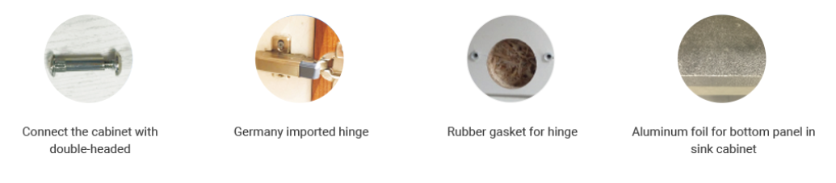
Website address to the below information shown
http://www.yudezign.com/product
Assembled with Double-headed Pins
German Imported Hinges
Rubber Gasket for Hinge
Bottom Panel Covered in Aluminum Sheeting for Sink Cabinet

Slide 15
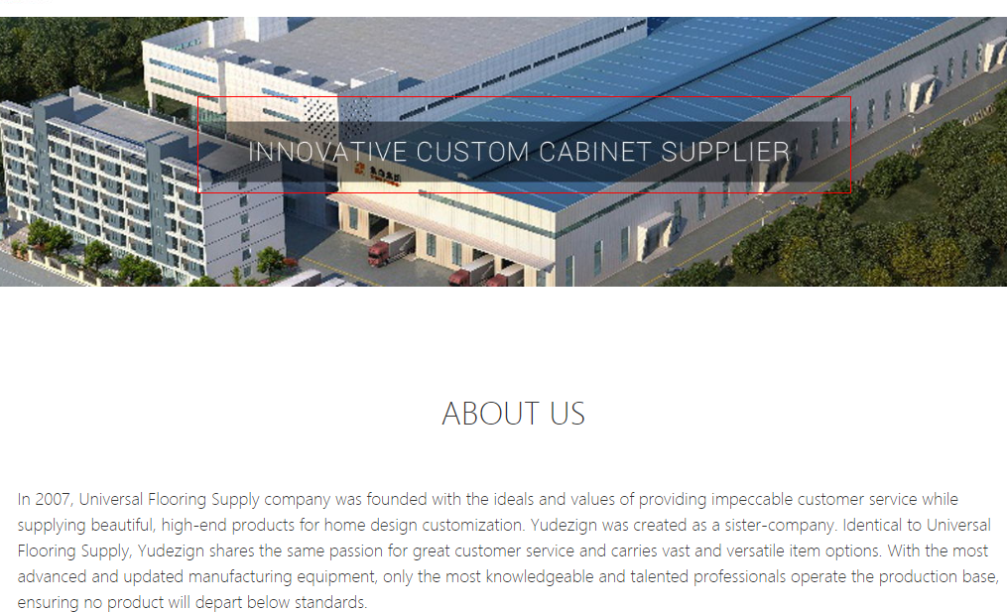
Website address to the below information shown
http://www.yudezign.com/about
In 2007, Yukon Group was founded with the ideals and values of providing impeccable customer service while supplying beautiful, high-end products for residential as well as commercial projects. We are proud to announce the establishment of a sister-company: Yudezign. Identical to Yukon regarding vision and values, Yudezign additionally offers vast and versatile custom cabinetry design options. Our US-based manufacturing site is equipped with the most advanced manufacturing equipment and talented professionals utilizing integrated design-to-completion software, ensuring delivery of consistently high quality products.

Slide 16
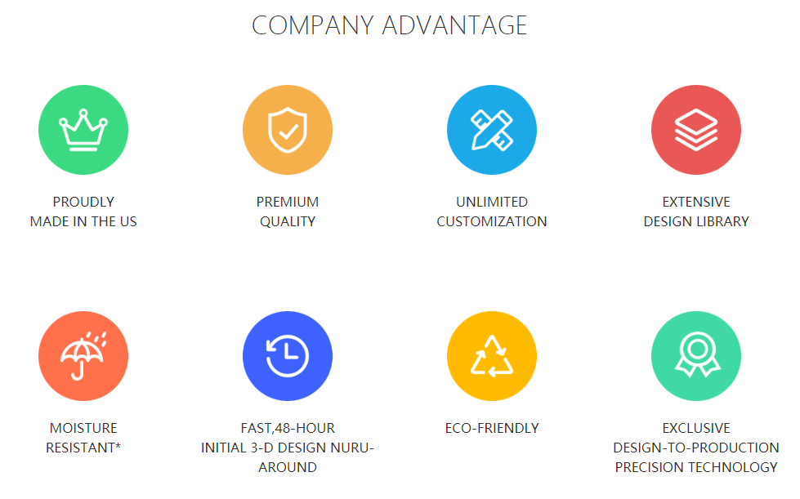
Website address to the below information shown
http://www.yudezign.com/about
RELIABLE AND DURABLE
FAST 48 HOUR INITIAL 3D DESIGN TURN-AROUND

Slide 17

Website address to the below information shown
http://www.yudezign.com/join
BUILD YOUR BUSINESS WITH YUDEZIGN

Slide 18
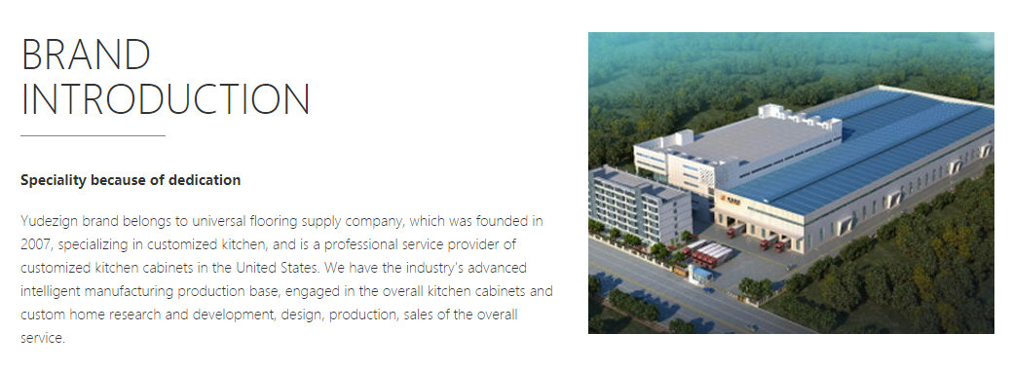
Website address to the below information shown
http://www.yudezign.com/join
BRAND
INTRODUCTION
删除
Yudezign is a sister-company of Yukon Group , which was founded in 2007, specializing in customization, and is a professional service provider of customized cabinetry . We utilize leading edge, intelligent technology in the design and manufacture of custom cabinetry offering start-to-finish service.

Slide 19
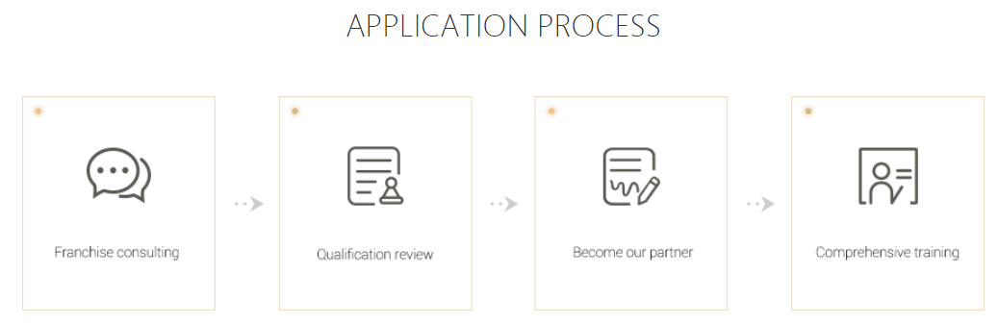
Website address to the below information shown
http://www.yudezign.com/join
DEALER APPLICATION PROCESS
提升如下四图高清度
New Dealer Inquiry
Dealer Training Process
当点击这个文件内容的时候，显示PPT19页的内容

Slide 20
Website address to the below information shown
http://www.yudezign.com/home
Step:1 改成为 Step 1:
下面的内容改为 Overview of Intelligent Software
Step:2 改成为 Step 2:
下面的内容改为 Display Requirements
Step:3 改成为 Step 3:
下面的内容改为 Product Knowledge
Step:4 改成为 Step 4:
下面的内容改为 Measuring Guide
Step:5 改成为 Step 5:
下面的内容改为 Sales Process

Slide 21

Website address to the below information shown
http://www.yudezign.com/join
COMPANY ADVANTAGE
We serve our clients with the highest quality products and service. Yudezign, partnering with Yukon Group, combines over 12 years experience. We take pride in our attention to detail, the quality of our products and our high level of customer service. As a sales partner, we will be there for you from design through production. Our goal is to make you stand out from others!
Intelligent Manufacturing
Advanced IT Solutions
Design Capabilities

Slide 22
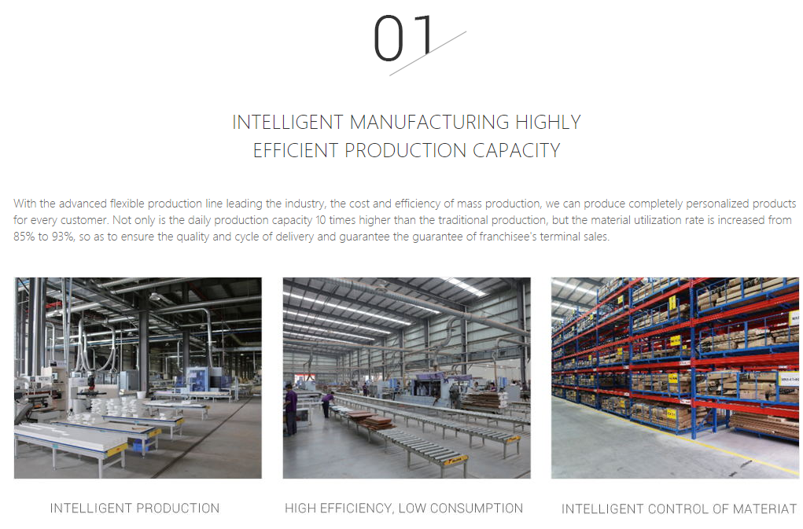
Website address to the below information shown
http://www.yudezign.com/join
INTELLIGENT MANUFACTURING
With the industry leading advanced, flexible production line, we can produce completely personalized products for every customer. Not only is the daily production capacity 10 times higher than the traditional production, but the material utilization rate is increased from 85% to 93%, while ensuring product quality and reducing the cycle of delivery. All aspects benefit the dealers' terminal sales.
INTELLIGENT CONTROL OF MATERIAL

Slide 23
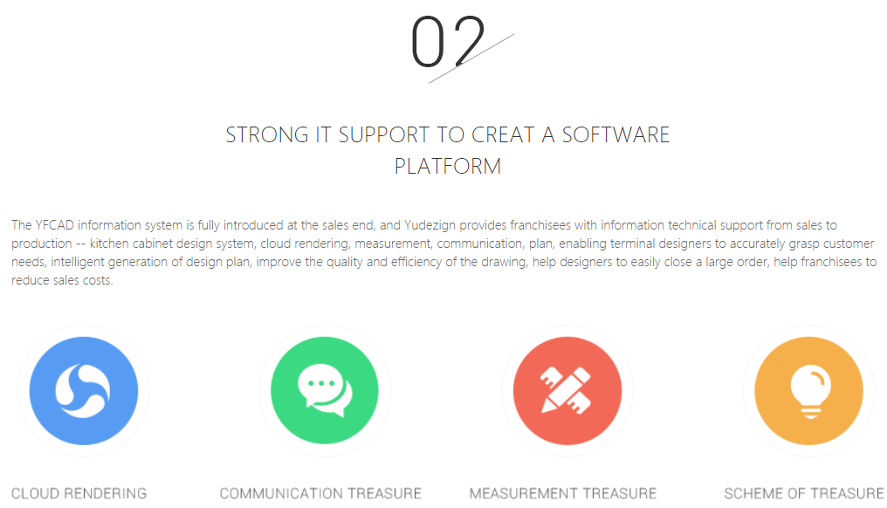
Website address to the below information shown
http://www.yudezign.com/join
Advanced IT Solutions
The YFCAD information system is fully introduced at the sales end and Yudezign provides dealers with IT support from sales to production – measurement guide, impressive cabinet design system, 3D cloud rendering and manufacture; enabling designers to accurately translate customer needs into the design.
注意：图标和文字排列顺序需更改为：COMMUNICATION MEASUREMENT CLOUD RENDERING 3D DESIGN OUTPUT
COMMUNICATION
MEASUREMENT
3D DESIGN OUTPUT
Notes:
3D Output

Slide 24
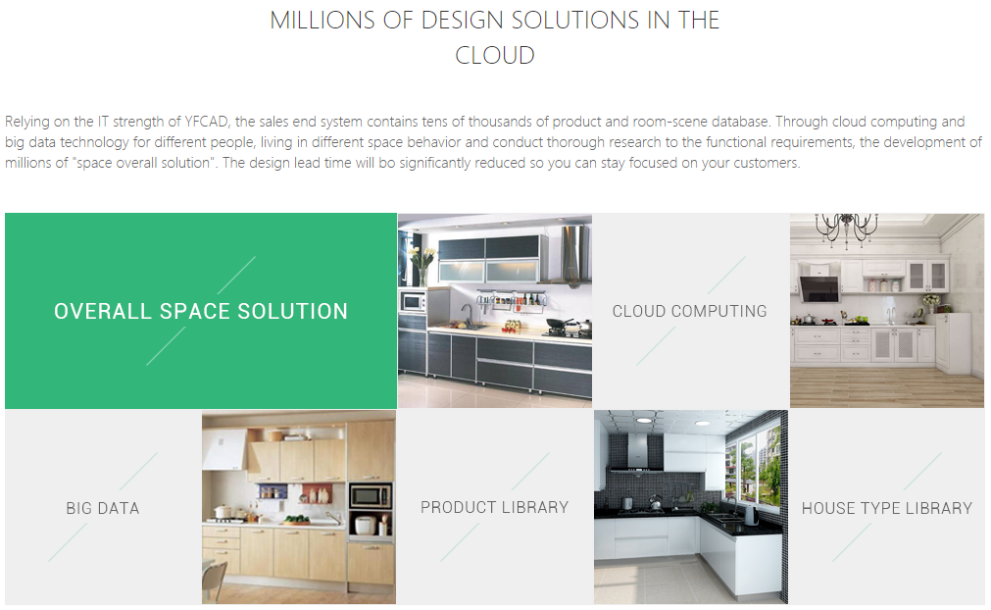
Website address to the below information shown
http://www.yudezign.com/join
Design Capabilities
3D design delivery allows the customer to“experience”their new space – before it happens. The software allows for changes in real time and while in 3D mode. The design lead time will be significantly reduced so you can stay focused on your customers.
Floor Plan Library

Slide 25

Website address to the below information shown
http://www.yudezign.com/join
Customized Cabinetry
Industry leading cabinetry built to the customer's specifications
THE EMERGING INDUSTRY LEADER
删除
A picture is worth a thousand words. Our 3D software, complete with furniture and accessories gives the customer a virtual view of what their new space will look like. Need some changes? No problem. Change the cabinet color, add an internal upgrade, replace a cupboard with drawers. Every customer has specific needs. Yudezign according to each individual's wants and needs.

Slide 26
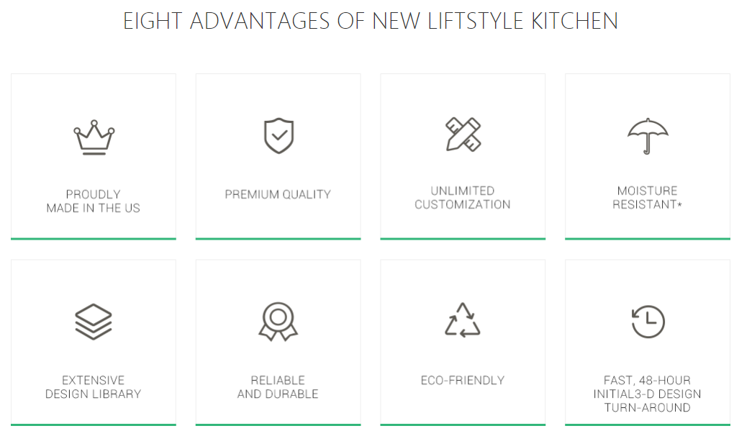
Website address to the below information shown
http://www.yudezign.com/join
FAST 48 HOUR INITIAL 3D DESIGN TURN-AROUND

Slide 27

Website address to the below information shown
http://www.yudezign.com/join
Platinum (Maximm Discount): Must have a full 10*10 foot display in showroom
Gold: Minimum display of 12 inch cabinet with one drawer and one door
Silver: Hand sample drawer to demonstrate quality as well as door finish samples
All Dealers will receive:
Door finish samples
Measuring guide
Design software with training provided
Catalogs (quantity to be determined)
Brochures (quantity to be determined)
Contact Yudezign to determine with dealer level will work best for you

Slide 28
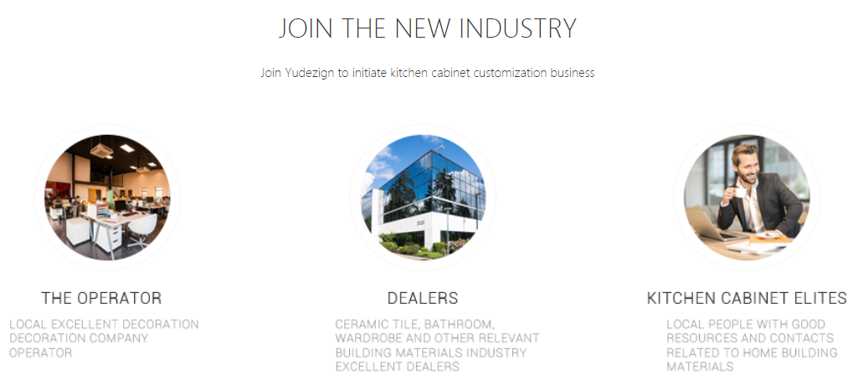
Website address to the below information shown
http://www.yudezign.com/join
Join Yudezign to initiate cabinetry customization business
INTERIOR DESIGN PROFESSIONALS & SMALL BUSINESSES
BUILDERS
注意，请删除每一个栏位下面内容栏内的内容

